Slide 1
Azure Ops Dashboard
One-click Azure environment visualization & AI-powered operational reports
FY26 GitHub Copilot SDK Enterprise Challenge

Slide 2
Business Value Proposition

Slide 3
The Problem
• Enterprise IT teams manage complex Azure environments across multiple subscriptions
◦ Visualizing requires juggling Azure Portal, CLI, Resource Graph, and manual docs
• Security posture and cost optimization reviews are manual and inconsistent
◦ No single tool provides As-Is diagrams + AI-driven operational insights

Slide 4
The Problem (cont.)
• Documentation becomes stale — environment drift goes undetected
• Teams need quick, repeatable environment snapshots for audits, reviews, handoffs

Slide 5
The Solution: Azure Ops Dashboard
• One-click data collection via Azure Resource Graph
◦ Inventories all resources, networking, security, cost data
• Draw.io architecture diagrams with Azure-official icons
◦ Inventory view + Network topology (VNet/Subnet hierarchy)

Slide 6
The Solution (cont.)
• AI-powered reports via GitHub Copilot SDK
◦ Security: Secure Score, Defender, recommendations
◦ Cost: spend breakdown, optimization, Advisor integration
• Diff reports: automatic comparison with previous runs
• Desktop GUI (tkinter) — no cloud deployment required

Slide 7
Business Value
• Time savings: Environment visualization in minutes, not hours
• Security: Early detection of misconfigurations and risks
• Cost optimization: AI-driven spend analysis and recommendations

Slide 8
Business Value (cont.)
• Drift tracking: Automated diff reports across time
• Reusability: Template system for customized reports per customer
• Amplification: Applicable to any Azure enterprise engagement

Slide 9
Demo & Screenshots

Slide 10
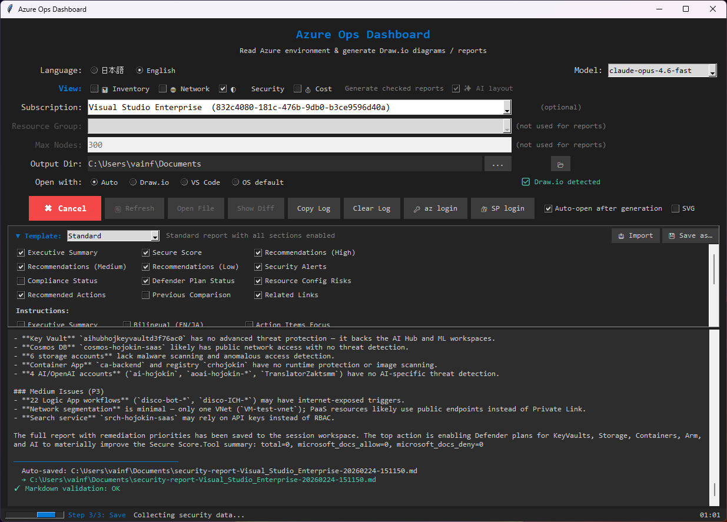
GUI — Collect & Diagram Generation

Slide 11
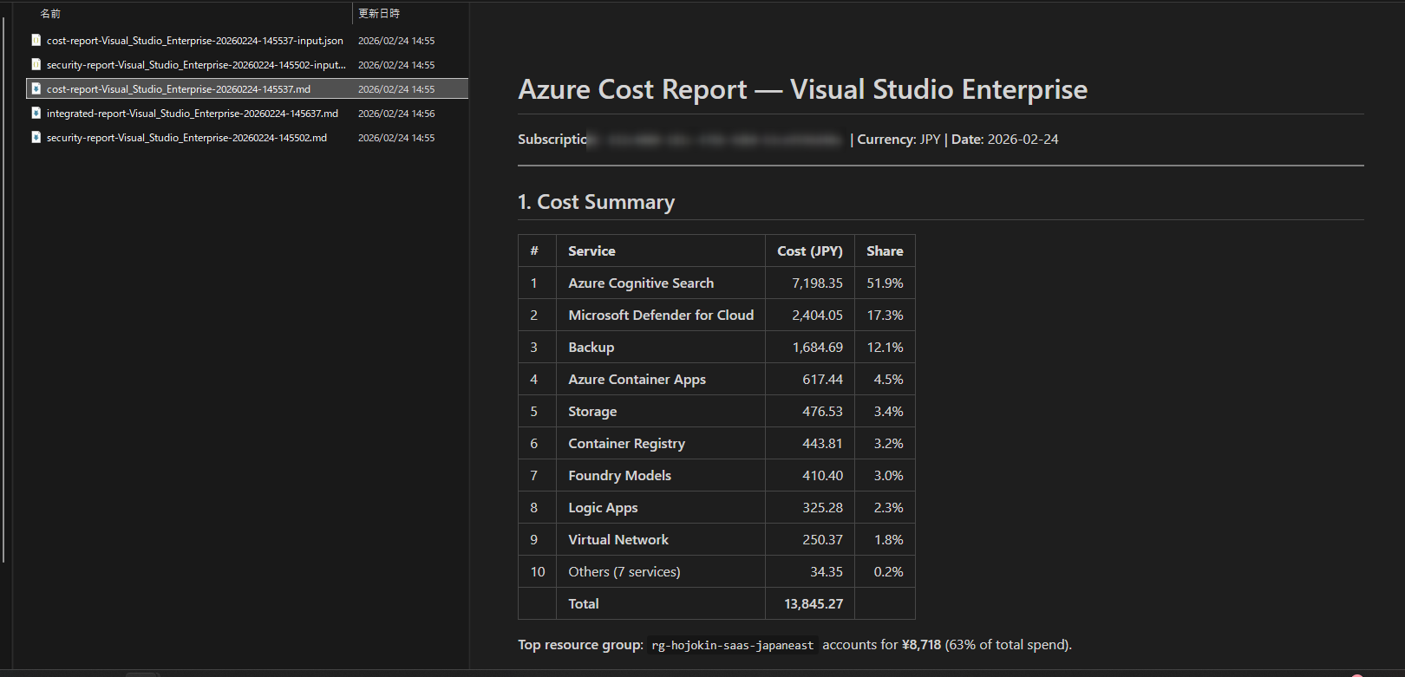
AI Report — Streaming Output

Slide 12
Architecture & Technical Highlights

Slide 13
Architecture Overview
• Desktop GUI (tkinter) with threaded background workers
• Data Collection: Azure CLI / Resource Graph / Security Center / Cost Mgmt / Advisor
• AI Engine: GitHub Copilot SDK (CopilotClient streaming sessions)
◦ Enrichment: Microsoft Learn Search API + MCP server

Slide 14
Architecture Overview (cont.)
• Output: Draw.io XML / Markdown / Word / PDF / diff reports
• Packaging: PyInstaller single-exe distribution
• Cross-platform: Windows (full + exe), macOS, Linux

Slide 15
GitHub Copilot SDK Integration
• CopilotClient with streaming token callbacks
◦ Dynamic model selection: claude-sonnet (latest) / gpt-4.1 fallback
• Read-only tool permissions (no write operations)
• Microsoft Docs MCP for document-grounded analysis

Slide 16
SDK Integration (cont.)
• Retry with exponential backoff + future.cancel() on timeout
• Thread-safe streaming UI: atomic buffer swap at 100ms
• Session hooks for tool permission control and observability

Slide 17
Azure Integration Points
• Azure Resource Graph — full inventory across subscriptions
• Microsoft Defender for Cloud — Secure Score, alerts, recommendations
• Azure Cost Management — spend by service/resource group

Slide 18
Azure Integration (cont.)
• Azure Advisor — optimization recommendations
• Microsoft Learn Search API — enrichment for AI reports
• Service Principal + Interactive login support

Slide 19
Key Design Decisions
• Template system: bundled defaults + user override (%APPDATA%)
◦ No exe rebuild needed to update report templates
• i18n: Japanese/English runtime switching (UI + reports)
• Read-only Azure operations only — Reader role minimum

Slide 20
Design Decisions (cont.)
• No secrets stored to disk — entered per-session via GUI
• 32 unit tests runnable without Azure/SDK connectivity
• Responsible AI: RAI notes, human oversight gates, least privilege

Slide 21
Repository & Links
• Repository: https://github.com/aktsmm/azure-ops-dashboard
• License: CC-BY-NC-SA-4.0
• Language: Python 3.11+
• Tests: 32 tests (python -m unittest tests)
• Docs: README.md (EN/JA), DESIGN.md, AGENTS.md, RAI notes

